Slide 1

Graphs & Graph Databases
Foundations
Picture by Jeremy Hiebert [http://www.flickr.com/photos/jeremyhiebert/]

Slide 2
Why Graphs?

Slide 3
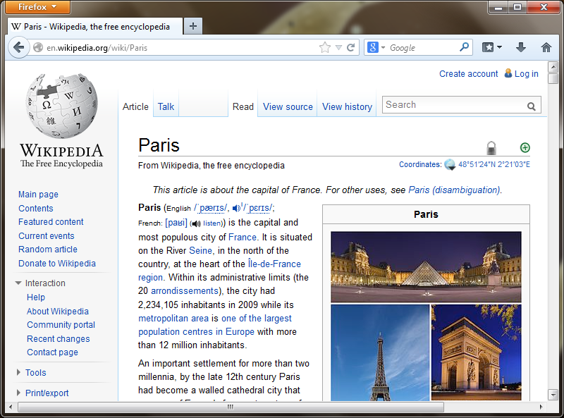
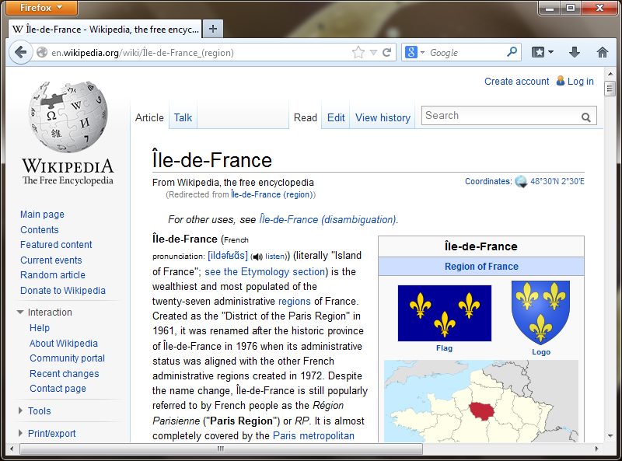
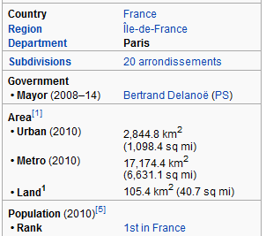
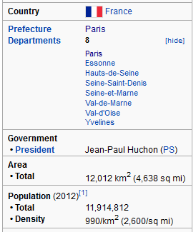
Wikipedia
Infobox

Slide 4
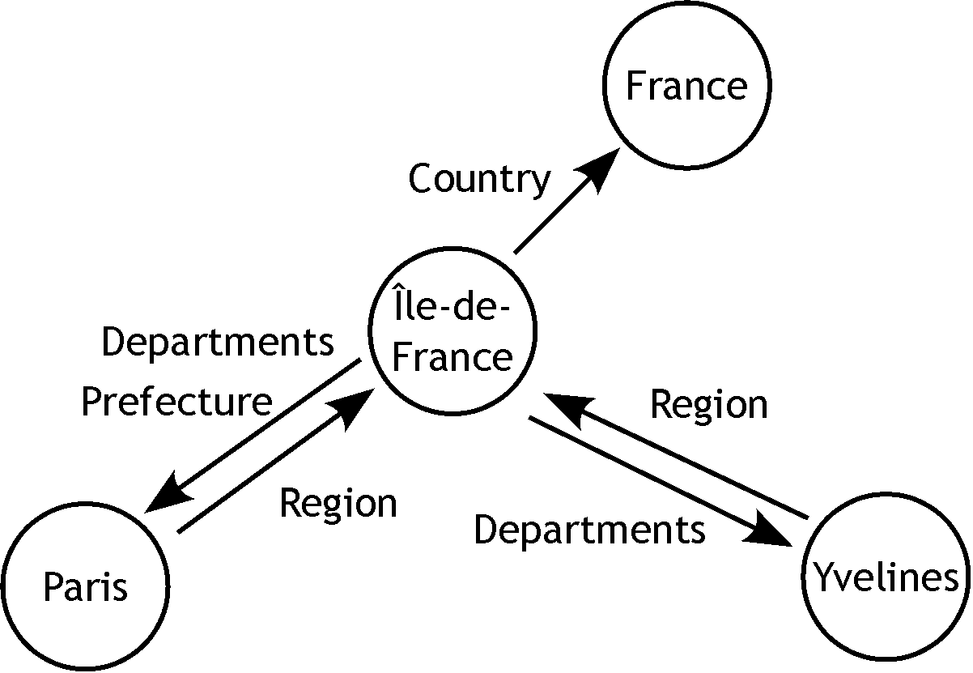
DBPedia

Slide 5
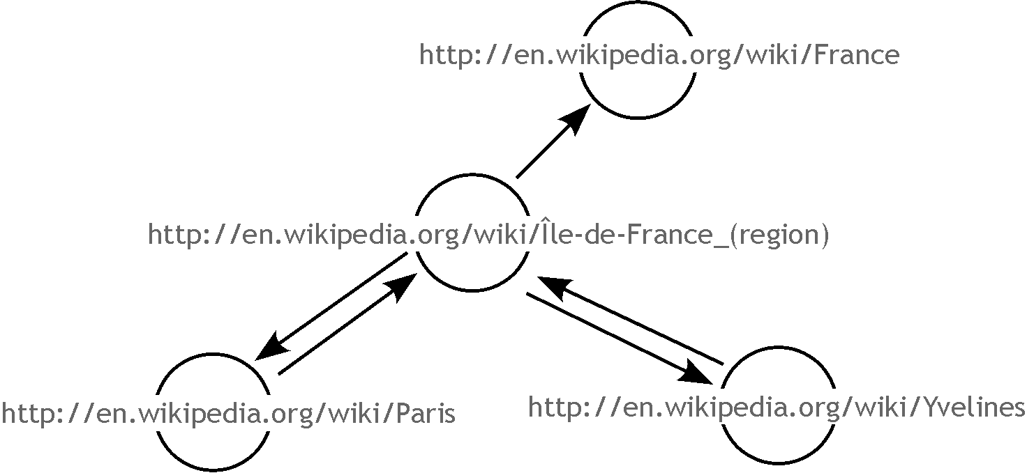
DBPedia (URIs)

Slide 6
DBPedia – English
4 million things
3.22 million classified in a consistent ontology
  832,000 persons
  639,000 places (427,000 populated)
  372,000 creative works
    116,000 music albums; 78,000 films; 18,500 video games
  209,000 organizations
  226,000 species
  5,600 diseases.

Slide 7
DBPedia – International
119 languages
24.9 million things
16.8 million interlinked with English
12.6 million unique things

Slide 8
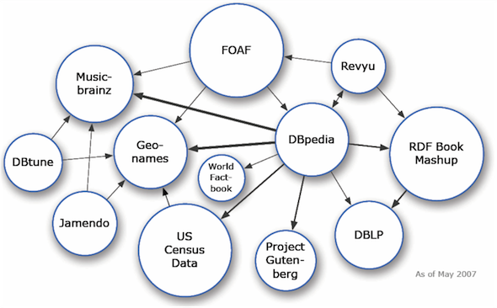
Linked Data
Source: http://lod-cloud.net/
Datasets published following Linked Data ‘format’: 05/2007
Notes:
‹#›

Slide 9
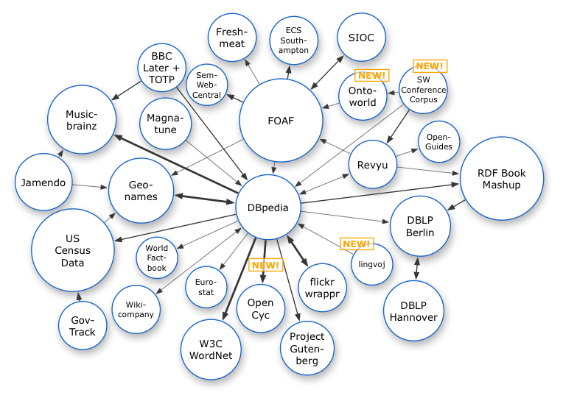
Linked Data
Source: http://lod-cloud.net/
Datasets published following Linked Data ‘format’: 11/2007
Notes:
‹#›

Slide 10
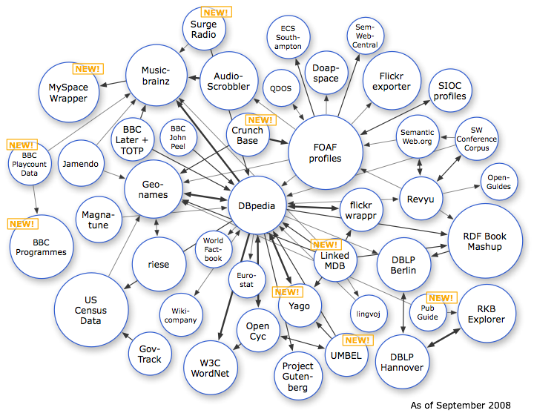
Linked Data
Source: http://lod-cloud.net/
Datasets published following Linked Data ‘format’: 2008
Notes:
‹#›

Slide 11
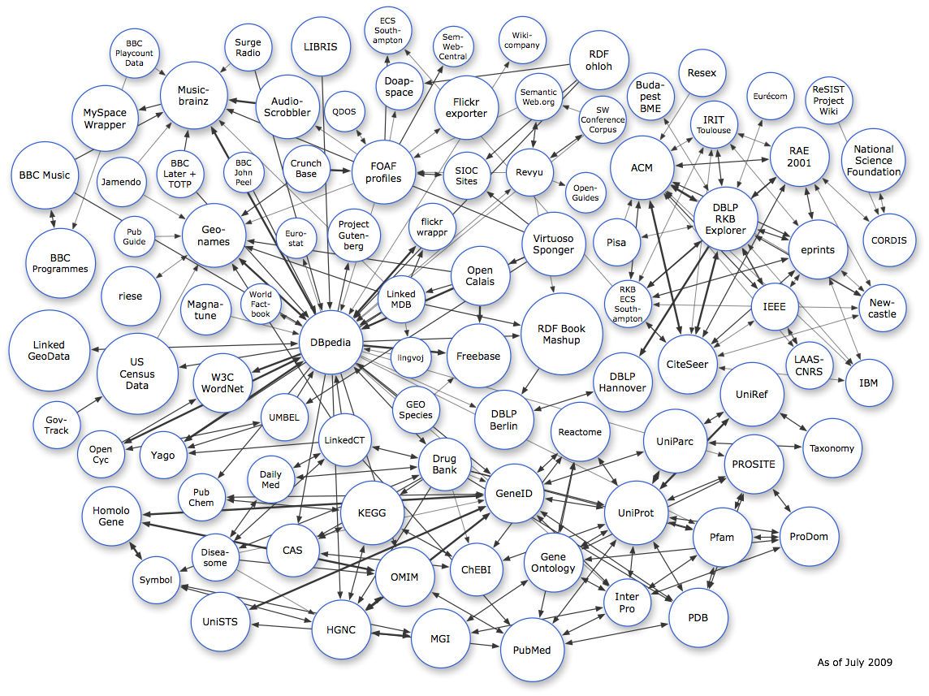
Linked Data
Source: http://lod-cloud.net/
Datasets published following Linked Data ‘format’: 2009
Notes:
‹#›

Slide 12
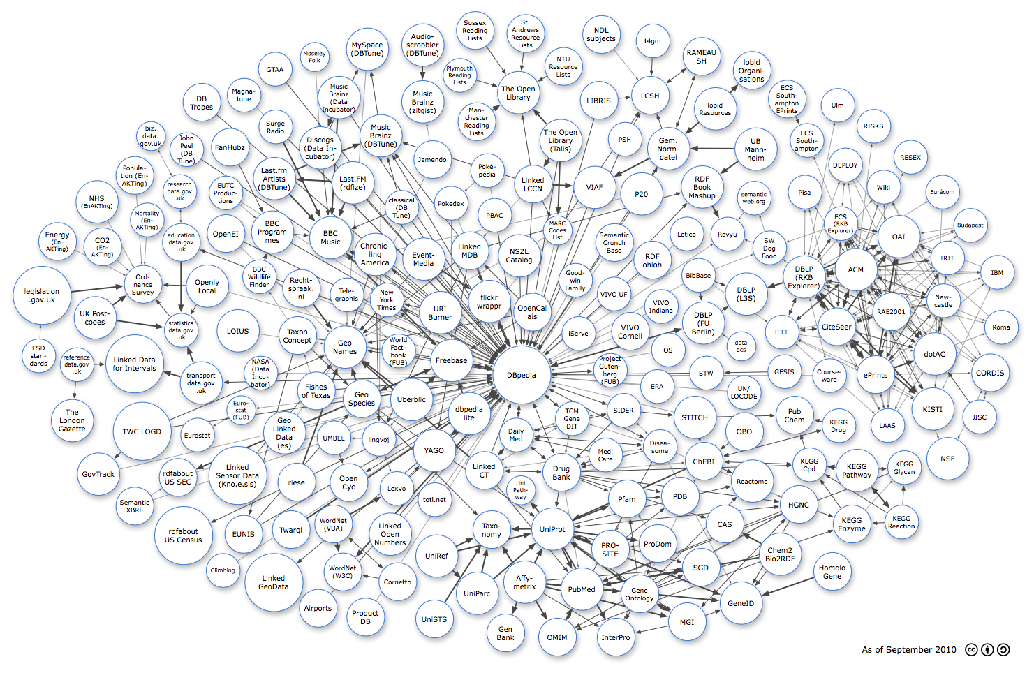
Linked Data
Source: http://lod-cloud.net/
Datasets published following Linked Data ‘format’: 2010
Notes:
‹#›

Slide 13
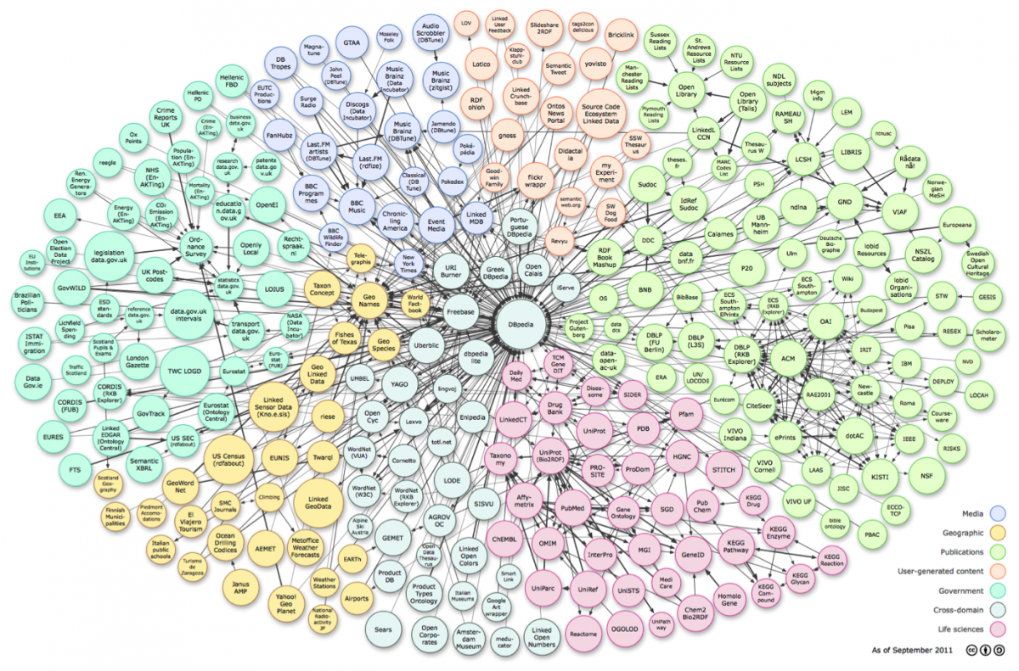
Linked Data
Datasets published following Linked Data ‘format’: 2011
Notes:
‹#›

Slide 14
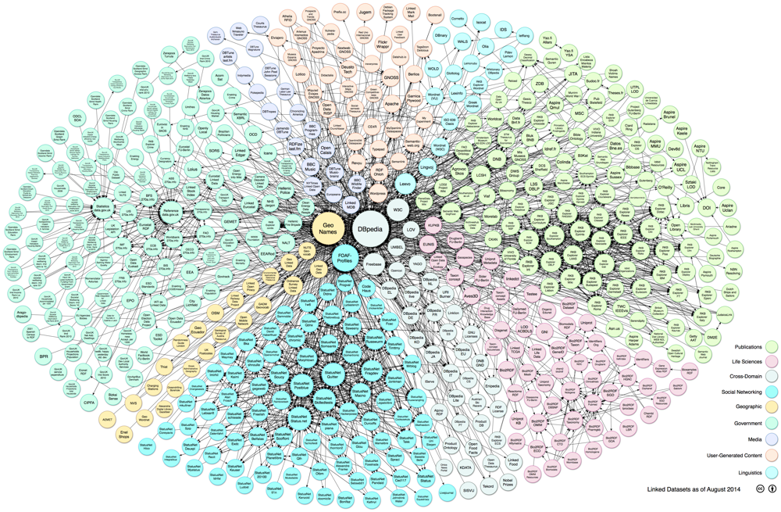
Linked Data
04/2014
Source: http://lod-cloud.net/

Slide 15
Graph Models

Slide 16
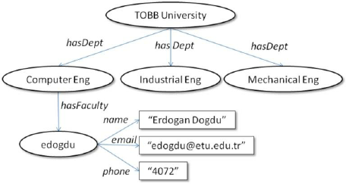
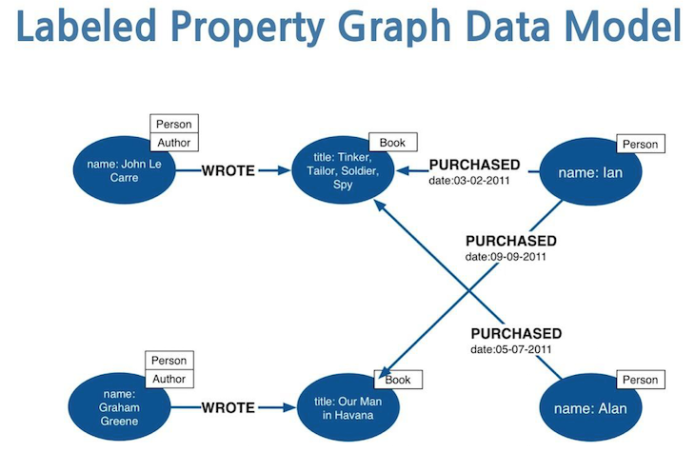
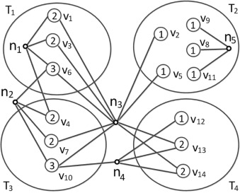
Graph Models

Slide 17
Graph Model
Property Graph

Slide 18
Property Graph
(node)
node

Slide 19
Property Graph
(node)
  Nodes can have properties
  (node { property: value })
node
node
property: value

Slide 20
Property Graph
(node)
  Nodes can have properties
  (node { property: value })
(node)-[edge]->(node)
node
node
property: value
node
edge
node

Slide 21
Property Graph
(node)
  Nodes can have properties
  (node { property: value })
(node)-[edge]->(node)
  Edges can have properties
  (node)-[edge {property:value}]->(node)
node
node
property: value
node
edge
node
node
edge
node
property: value

Slide 22
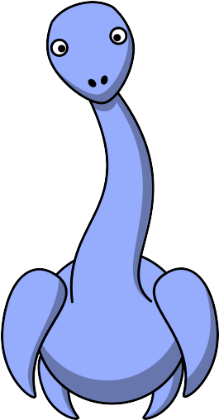
Plesiosaurus in a Property Graph
MNHN A. C. 8592

Slide 23
Plesiosaurus in a Property Graph
MNHN A. C. 8592
size: 5
recognized: 1830

Slide 24
Plesiosaurus in a Property Graph
Plesiosaurus dolichodeirus
is a
MNHN A. C. 8592
origin
size: 5
recognized: 1830
England
Lyme Regis
country

Slide 25
LSID Surrogate
LSID:123456
is a
label: Plesiosaurus dolichodeirus
popular@pt-BR: Plesiossauro
MNHN A. C. 8592
origin
size: 5
recognized: 1830
England
Lyme Regis
country

Slide 26
URI Identifiers
LSID:123456
is a
label: Plesiosaurus dolichodeirus
popular@pt-BR: Plesiossauro
MNHN A. C. 8592
origin
size: 5
recognized: 1830
wiki:England
wiki:Lyme_Regis
country
label: Lyme Regis
label: England

Slide 27
Property in the origin edge
LSID:123456
is a
label: Plesiosaurus dolichodeirus
popular@pt-BR: Plesiossauro
MNHN A. C. 8592
discovered: 1824
origin
size: 5
recognized: 1830
wiki:England
wiki:Lyme_Regis
country
label: Lyme Regis
label: England

Slide 28
Back to the Property Graph
Plesiosaurus dolichodeirus
label
LSID:123456
popular: pt-BR
is a
Plesiossauro
5
size
MNHN A. C. 8592
recognized
1830
origin
wiki:Lyme_Regis

Slide 29
Two properties for origin
Plesiosaurus dolichodeirus
label
LSID:123456
popular: pt-BR
is a
Plesiossauro
5
size
MNHN A. C. 8592
recognized
1830
origin
wiki:Lyme_Regis
place
discovered
1824

Slide 30
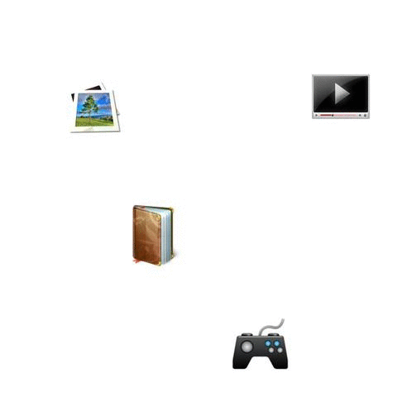

Slide 31
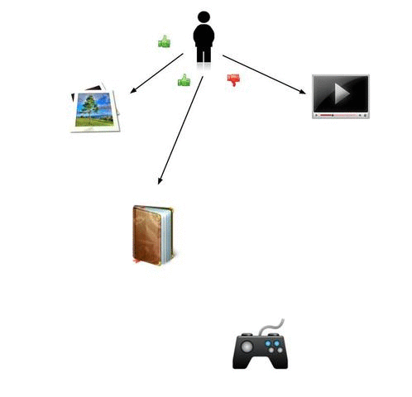

Slide 32
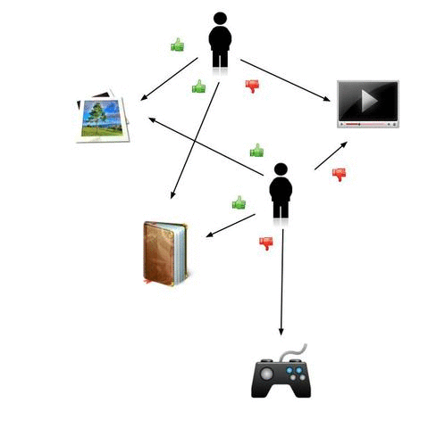

Slide 34
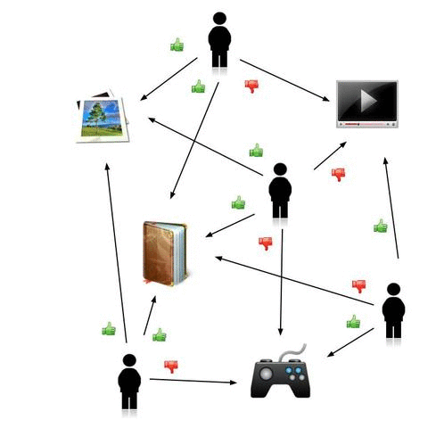

Slide 35
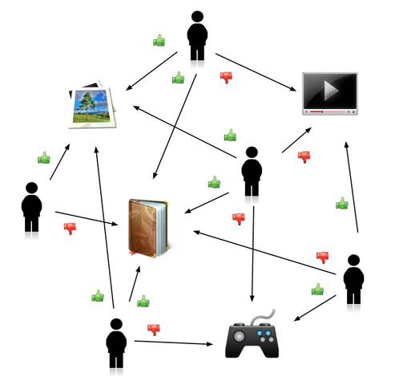

Slide 36
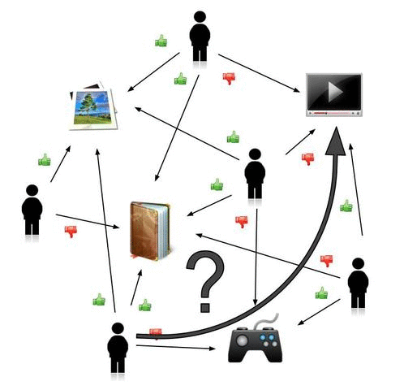

Slide 37
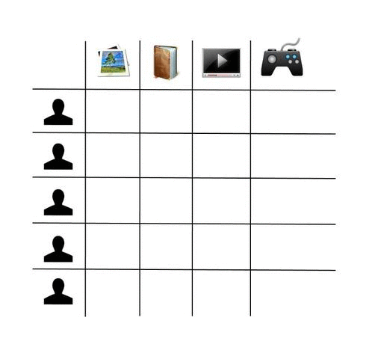

Slide 38
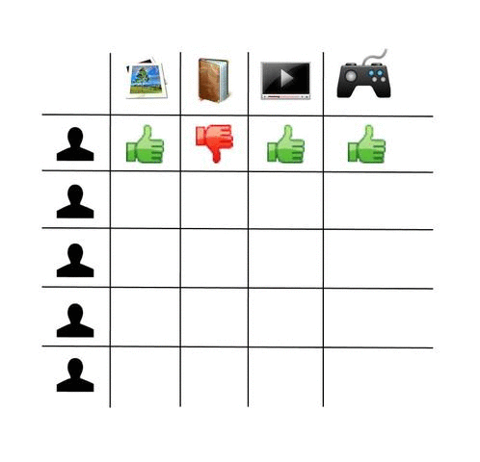

Slide 39
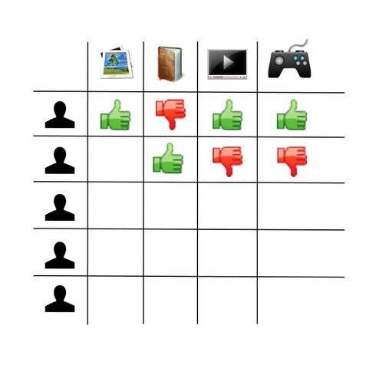

Slide 40
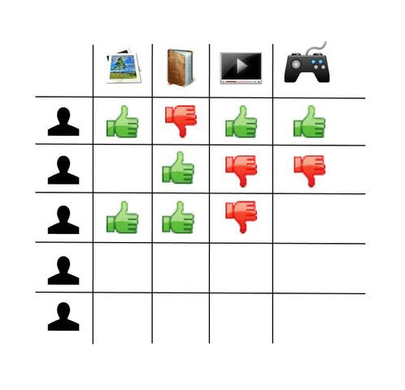

Slide 41
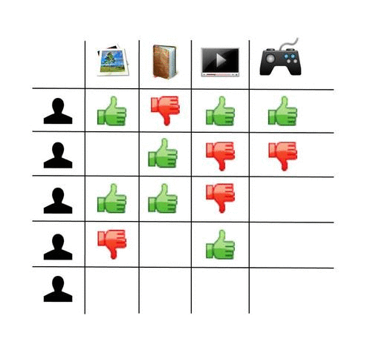

Slide 42
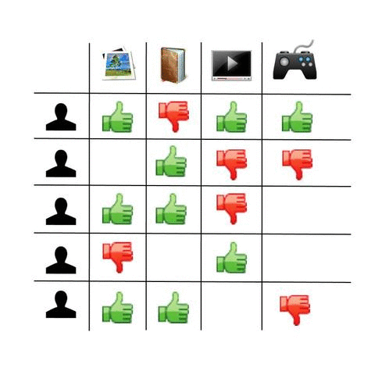

Slide 43
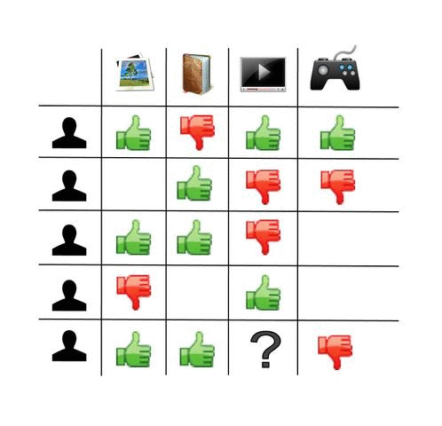

Slide 44
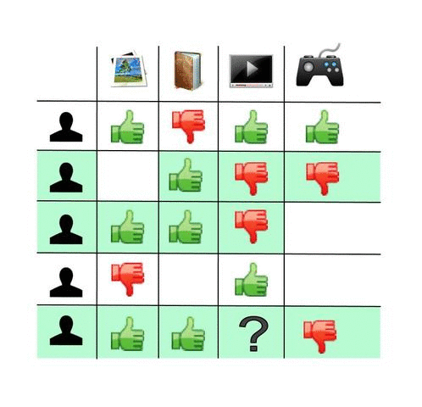

Slide 45
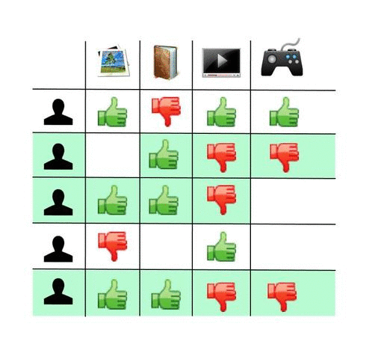

Slide 46


Slide 47
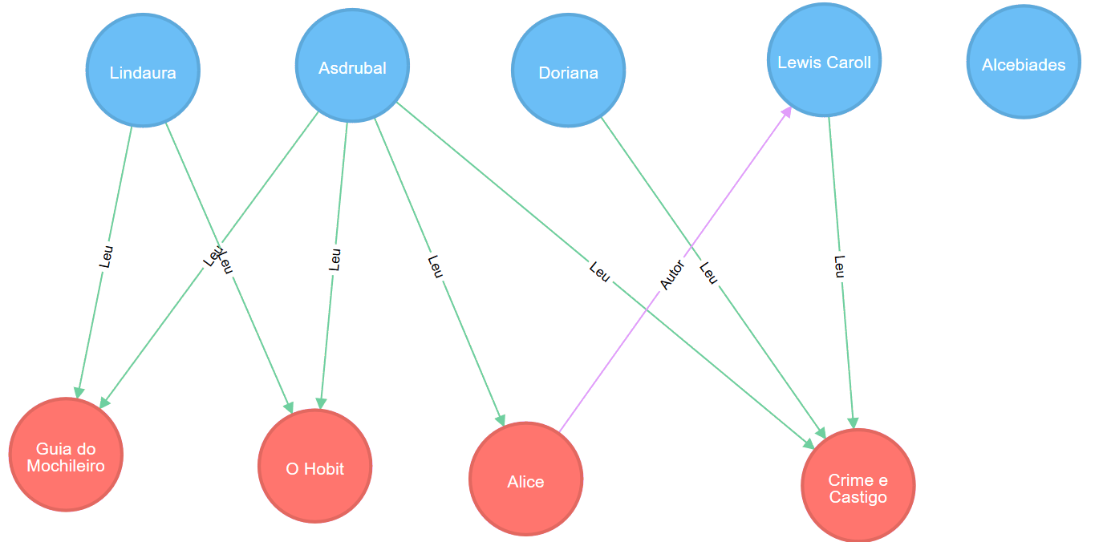

Slide 48
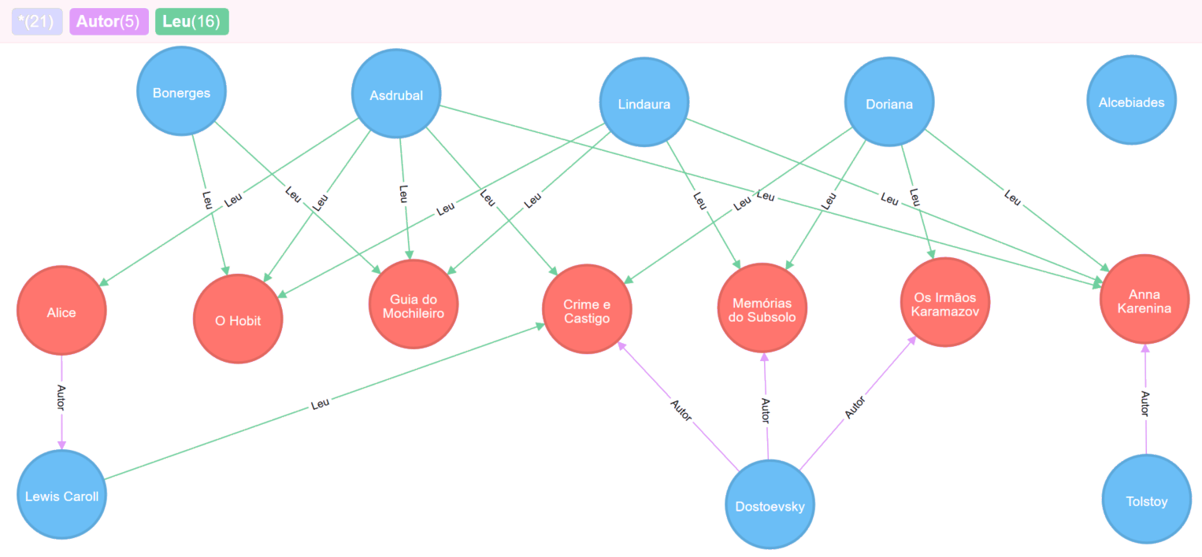

Slide 49
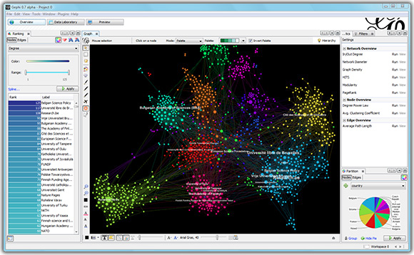
Data viz tools for graphs
Gephi

Slide 50
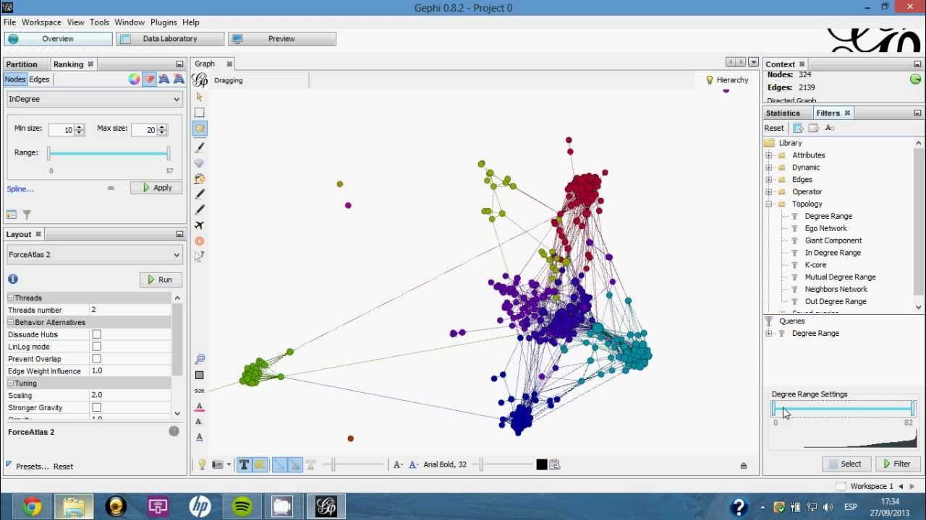
Data viz tools for graphs
Gephi

Slide 51
Data viz tools for graphs
Python + Jupyter:
Simple Examples: https://nicolewhite.github.io/neo4j-jupyter/hello-world.html
Analyzing the Panama Papers with Python & Neo4j:
https://nicolewhite.github.io/neo4j-jupyter/panama.html

Slide 52
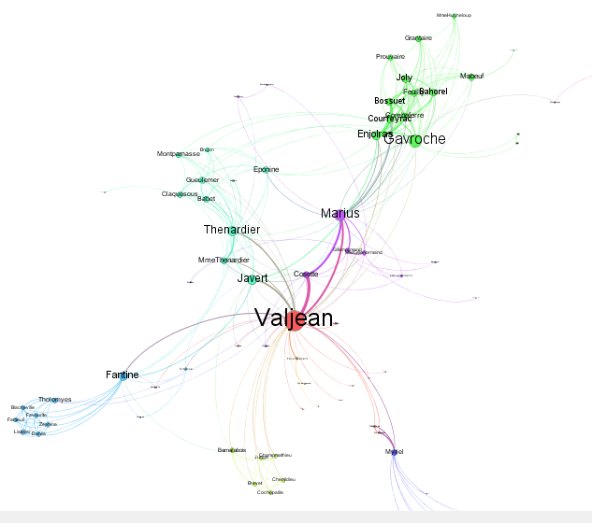
Les Miserables
(Neo4j example)

Slide 53
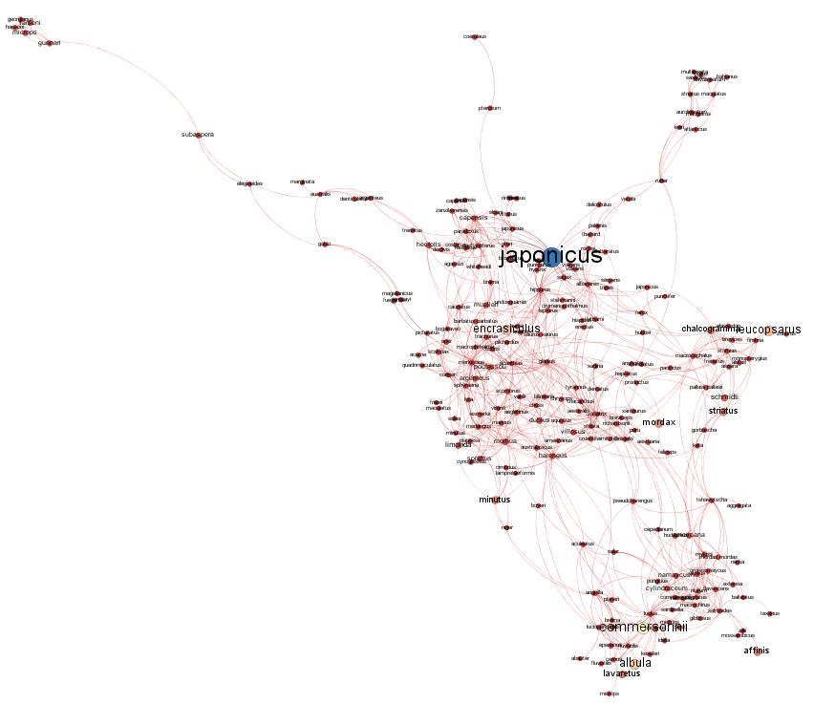
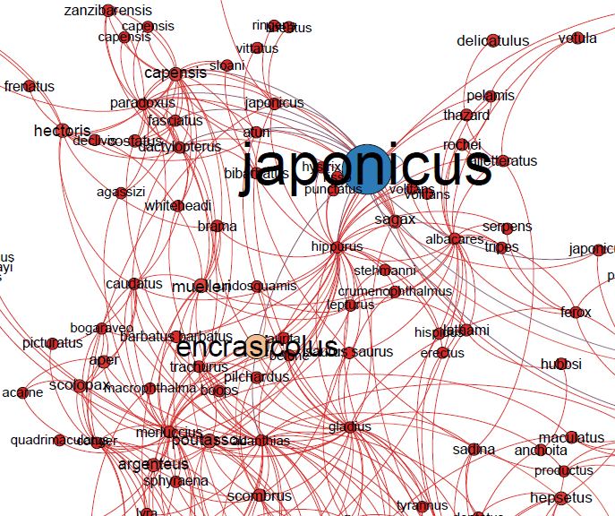
Cadeia Alimentar
FishBase

Slide 54
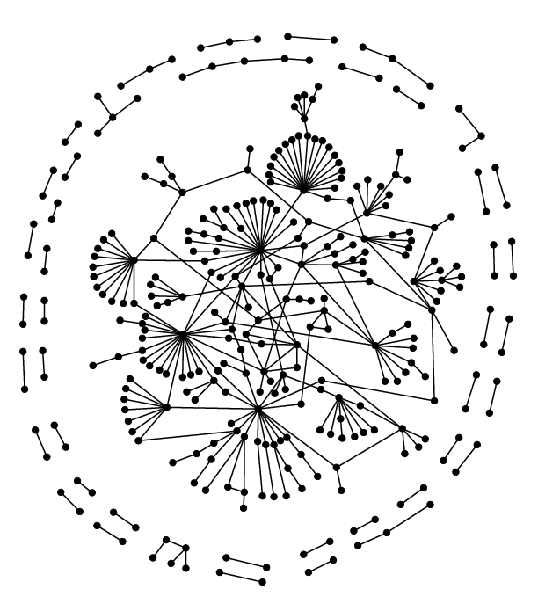
Yeast proteins
Yeast proteins: Sergei Maslov and Kim Sneppen,
Specificity and stability in topology of protein networks,
Science 296, 910-913 (2002).

Slide 55
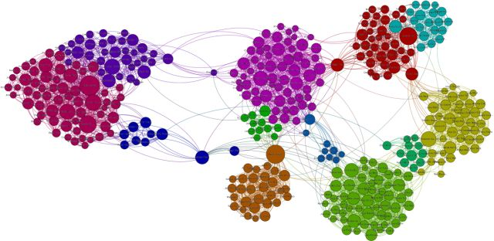
Graph Topology

Slide 56
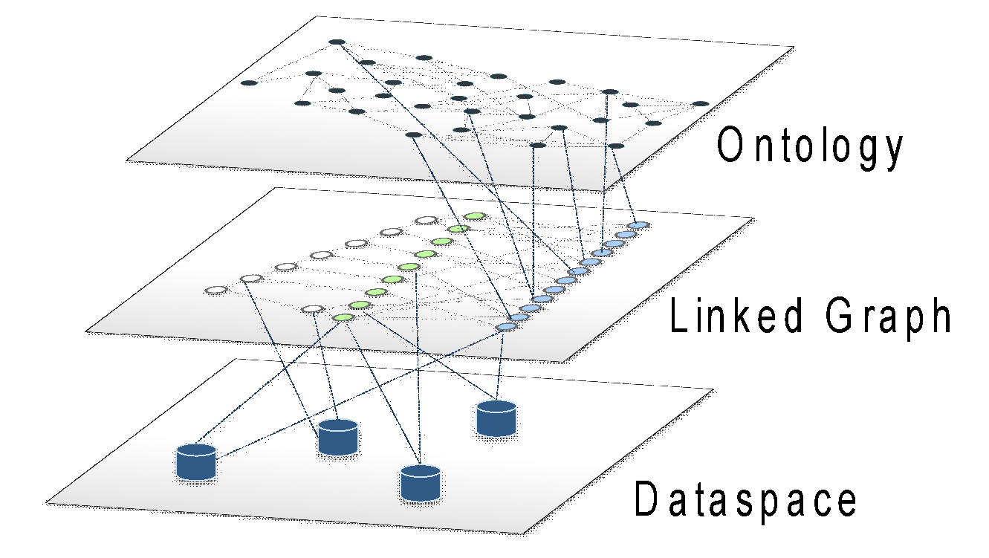
From Dataspaces to Ontologies

Slide 57
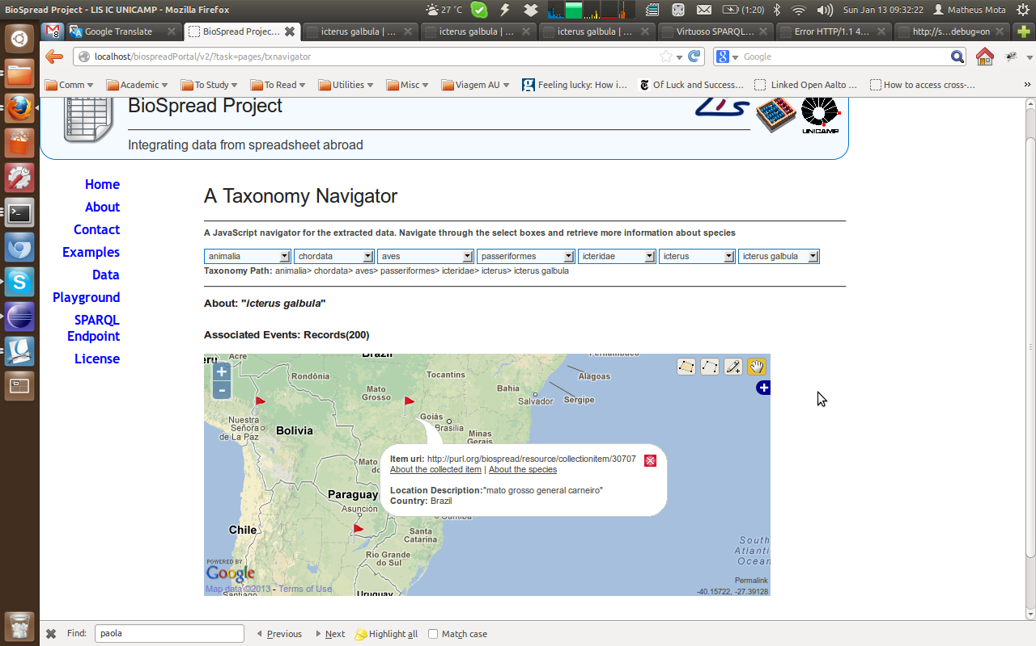
Data Exploration Prototype

Slide 58
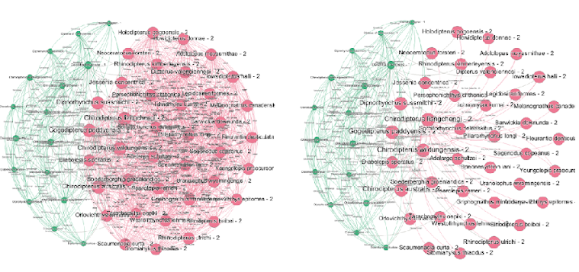

Slide 59
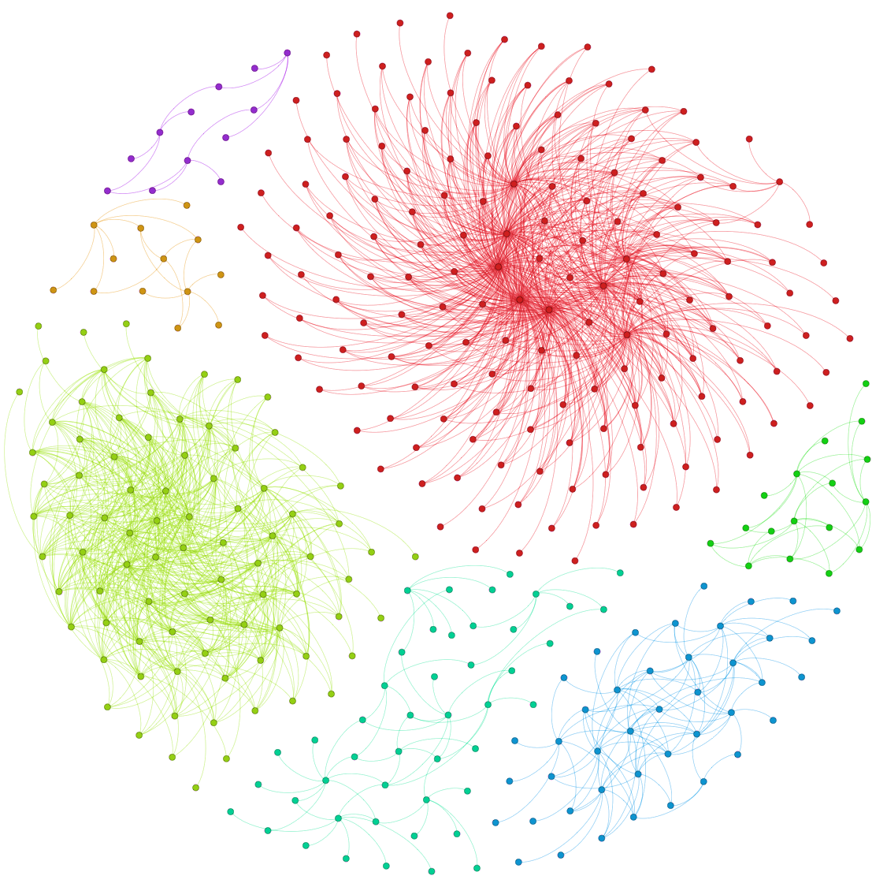
7 distinct morphological descriptions:
genus Varanus
Varanus gouldii
Varanus indicus
Varanus prasinus
Varanus salvator
Varanus spiny
Varanus timorensis
‹#›
Notes:
‹#›

Slide 60
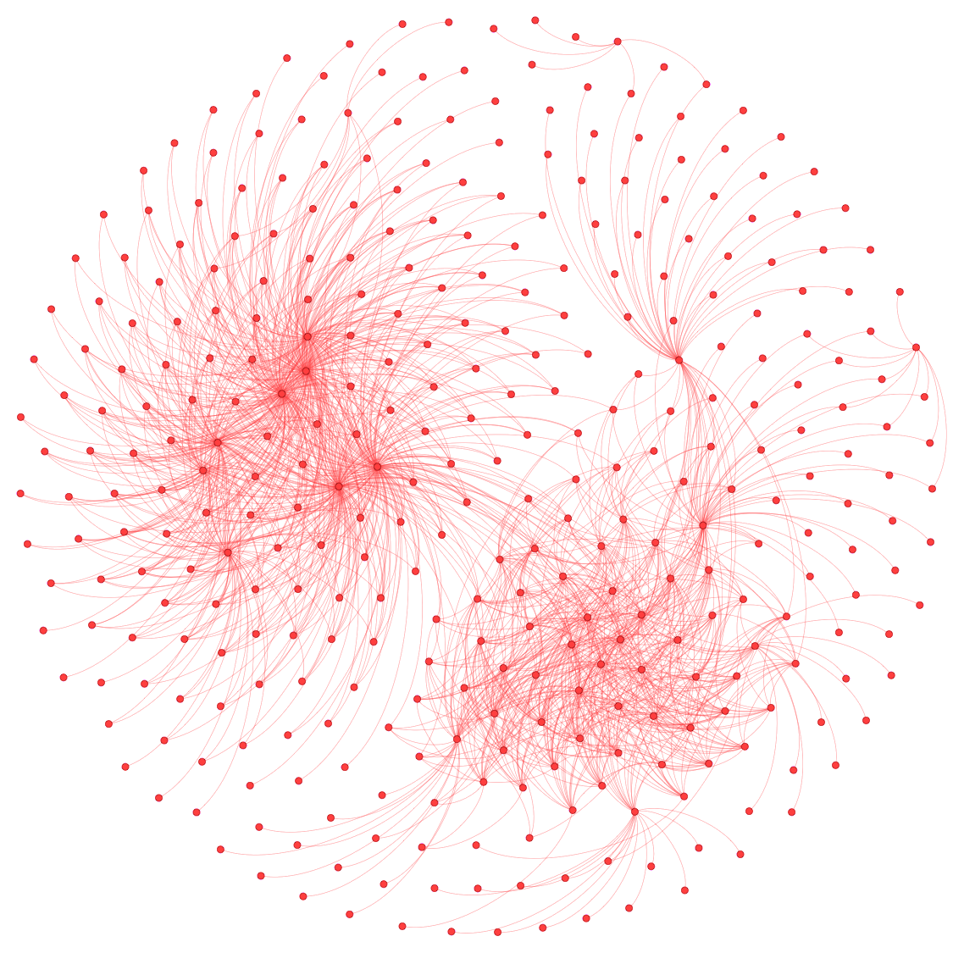
7 distinct morphological descriptions:
genus Varanus
Varanus gouldii
Varanus indicus
Varanus prasinus
Varanus salvator
Varanus spiny
Varanus timorensis
‹#›
Notes:
‹#›

Slide 61
Demo

